Slide 1
SKINS
Why MTV cancelled Skins

Slide 2
About the TV show
The TV show an adaptation a highly critically acclaimed and a fans favorite British series, became one of MTV’s most talked about shows ever when the Parents Television Council characterized it as possibly.
The film was created by Brian Elsley and Jimmy Brittain, and directed by Scott Smith and Samir Raheem
Brian Elsley is a famous Scottish Screen Writer involved the creation of other teenage films including Nature boy and Young Persons Guide to Becoming a Rockstar
The film entails the story of young teenager that engage in underage sex and abuse of drugs.
The TV show was first aired between January 17 and March 21 in 2011 in America.

Slide 3
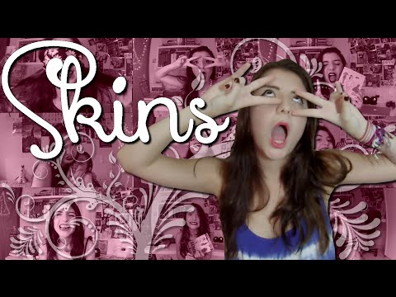
About the TV show
https://www.youtube.com/watch?v=JrjXnCTjXgU

Slide 4
Controversy
Despite its success in British television the Parents Television Council still considered it “the most dangerous television show for children that we have ever seen.”
The film opted to use teenage actor (mostly 15 years old) to maintain the originality of the British version which used actors with the same age as the characters.
There film was surrounded by claims of child pornography which prompted investigation by FBI.
MTV cancelled the show after airing all the episodes of the first season.

Slide 5
Why it was banned
According to HIBBERD (2011), the fall of the TV show started when most of the advertisers and sponsor cut off the funding.
The movies also was not well received among the public because it raise a lot of ethical issues among Americans.
The Involvement of underage teenagers in the movie to perform adult acts was another scene that was not will received by many Americans.
The final blow hit when the FBI investigated the movie for possible child pornography.

Slide 6
References
HIBBERD, J. (2011, June 09). MTV cancels Skins. Retrieved March 29, 2018, from http://ew.com/article/2011/06/09/mtv-cancels-skins/

